Slide 1

UNH SEDS
Senior Design Project
2018-2019

Slide 2
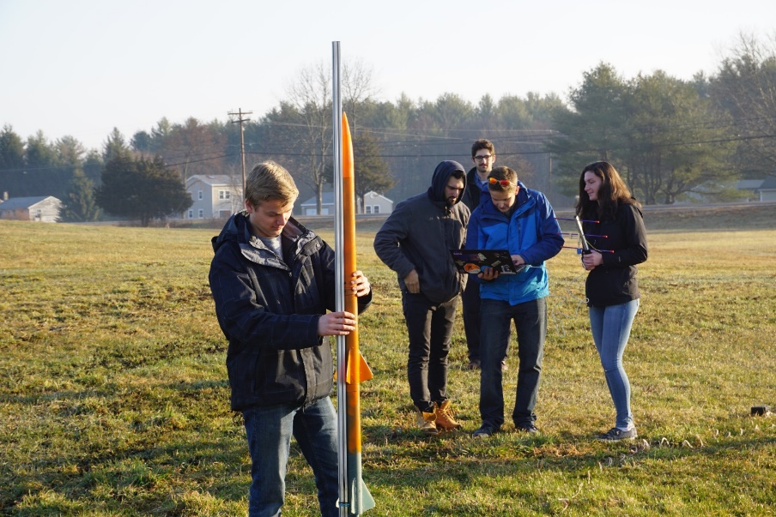
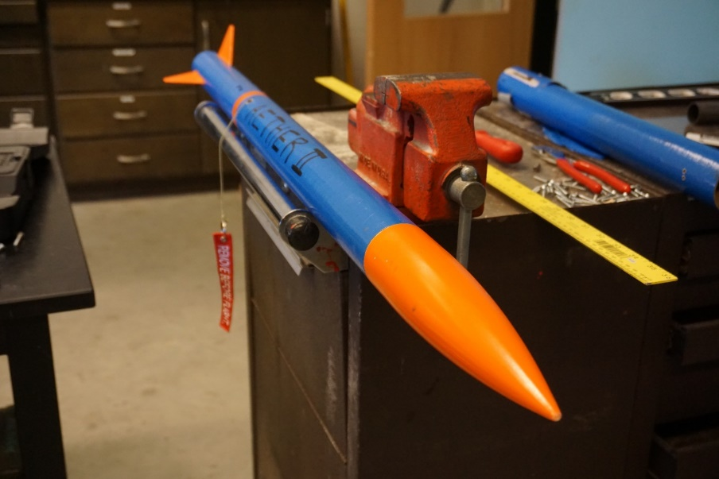
What is UNH SEDS?
Students for the Exploration and Development of Space (SEDS) is a non-profit that empowers young people to participate and make an impact in space exploration. SEDS helps students develop their technical and leadership skills by providing opportunities to manage and participate in national projects as well as to attend conferences.
We are an interdisciplinary rocketry organization founded in 2017 that has members from 6 different majors and every class.
Notes:
Seds is a naitionwide organization that allows colleges from around the world to start a chapter. Although we are allowed to do whatever we would like as an organization, they do sponsor competition for SEDS groups as well as national conferences, the next one for the beginning of November. We are a team comprised of many majors and all classes, so applying to join our team would not only be a senior project, but an interdisciplinary experience.

Slide 3
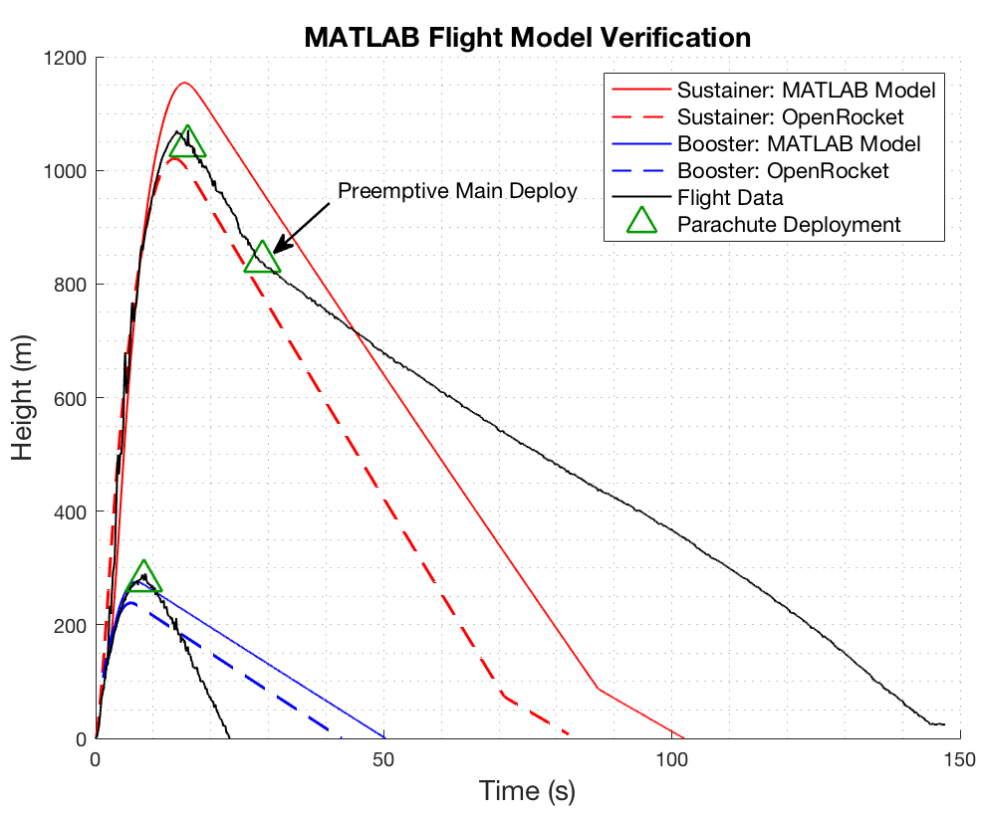
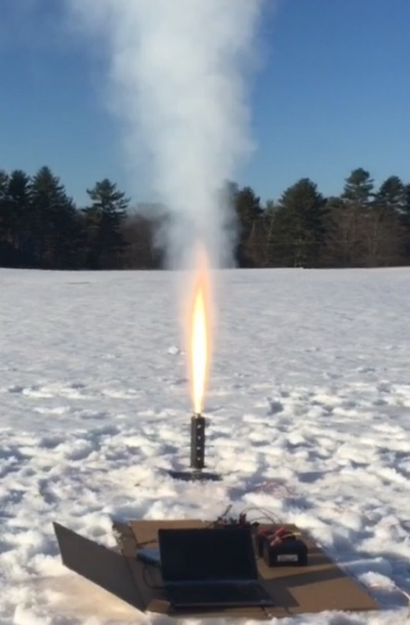
What Have We Done?
Worked on increasing our ‘Body of Knowledge’ in rocketry building techniques by building and launching eight rockets in a local field nearby.
Created and optimized launch simulations to accurately predict the flight path of each rocket flown
Used MATLAB to optimize rocket dimensions to maximized altitude reached
Measured thrust of our engines using a static test fire rig to more accurately predict the flight path of our rocket

Slide 4
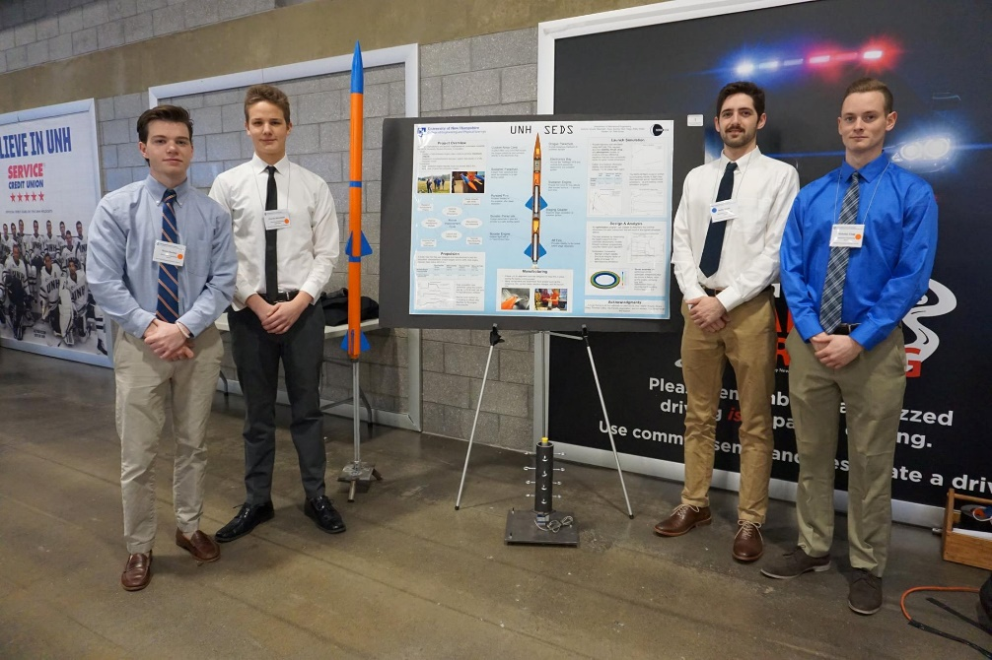
What Have We Done?
Placed second place at the URC in the mechanical engineering competition teams
Currently at work in participating in the University Student Rocketry Competition in October 2018

Slide 5
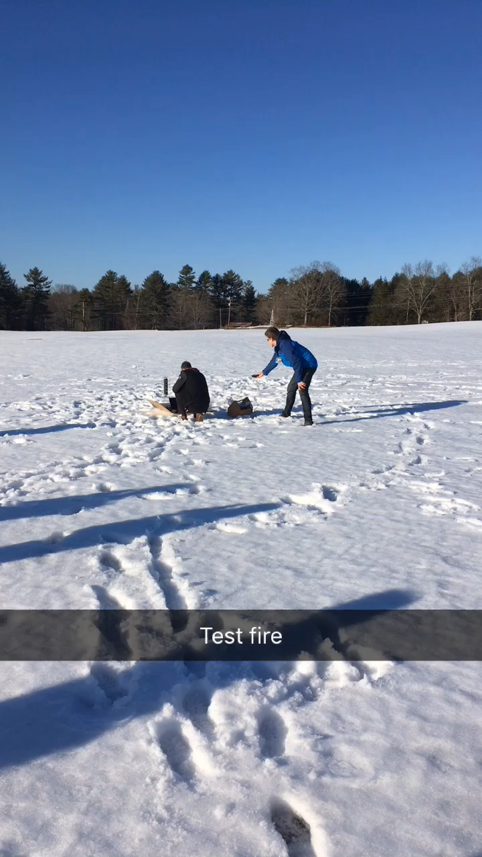
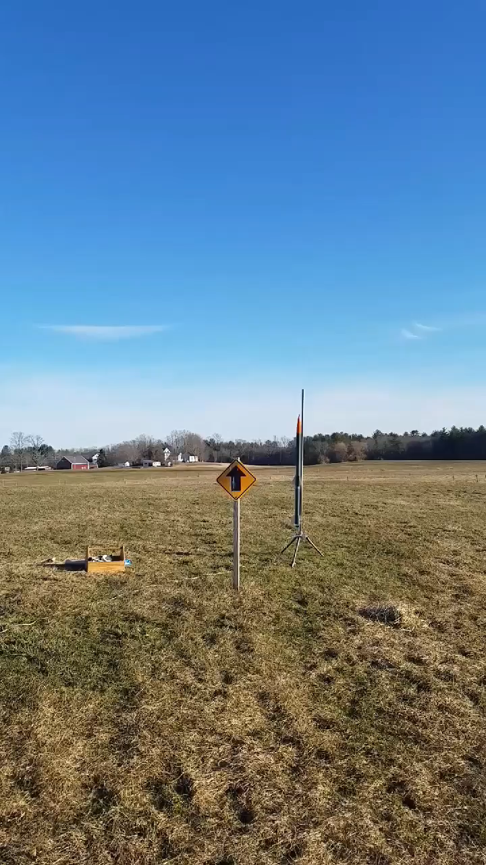
Examples…
Our static test fire for our competition booster engine
Our first successful multistage rocket

Slide 6
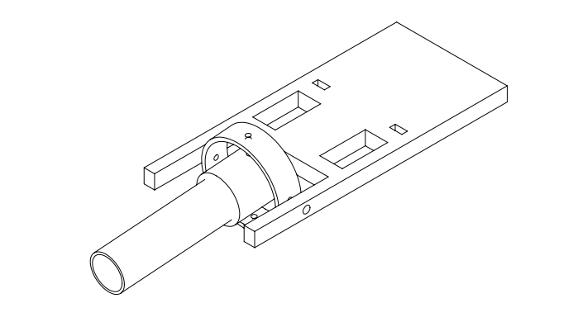

Goals for UNH SEDS 2018-2019
Finish participation in the University Student Rocketry Competition
An incorporated hybrid rocket engine with gimbal assembly
Compete in SpacePort America Cup
Gimbaled Hybrid Engine, carbon fiber body
Flight computer on board to control thrust, staging events and recovery.
Notes:
Note these are our technical goals, we have many plans to begin outreach events to inspire others to enter STEM and get inspired with space exploration

Slide 7
Senior Design Project
Searching for 4-5 Senior Mechanical Engineering majors to assist in all aspects of UNH SEDS which primarily includes:
The design and manufacturing of a hybrid rocket engine with an integrated guidance system
Major testing and optimization needed through the year to achieve a nominal hybrid engine
The design and manufacturing of a payload to be deployed at apogee for a specific scientific recording
Compete in the Spaceport America Cup in June 2019.
Also a huge networking event where recruiters from around the world come including NASA, SpaceX and Blue Origin

Slide 8
Spaceport America Cup Video
https://www.youtube.com/watch?time_continue=2&v=lTKRDd1ovAs

Slide 9
What else?
UNH SEDS will also host two EE and one CS senior project to support the development of our electronic and software systems.
We will present at the URC 2019 in the mechanical engineering competition team bracket and the EE and CS seniors will present in their own.
SEDS USA hosts a national conference every year called ‘SpaceVision’ where many of the various SEDS chapters congregate to network and listen to speakers. This year, it is on November 2018 in San Diego, California.
This isn’t just a senior project, but joining a family that participates in outreach and networking events with nearby SEDS chapters (UM and MIT). Senior Project Member prospects must be interested to participate in all aspects of what UNH SEDS does

Slide 10
Want to join?
We are recruiting seniors for the senior design project starting next week.
If interested, email: CJN1012@WILDCATS.UNH.EDU over the weekend to begin the recruitment process.
Interviews will begin next week.

Slide 11
Questions?

